Slide 1


ABI Summer 2021 Introduction to Statistics
Guest Session 3
Javier Cabrera*, Volha Tryputsen** & Davit Sargsyan**
July 13, 2021
(*)Rutgers, the State University of New Jersey
(**)Janssen Pharmaceutical Research and Development (J&J)

Slide 2
Group Assignment
Group 1 | Group 2 | Group 3 | Group 4 | Group 5
Gisane (R) | Arabo (R) | Susie (R) | Tamara (R) | Mher (R)
Arvin | Nerses | Ashkhen | Vardan | Vika
Satenik | Liana | Anush (R) | Hripsime | Nelli

Slide 3



The Royal Guinea Pig Problem
Available resources:
Castle basement full of mice and rats
2 types of diet: regular grass or carrot-rich
3 natural compounds to use as treatments
The Guinea pig lost appetite and began losing weight . It even stopped eating its favorite treat - carrot
You are commissioned to find a cure for Peppa – and get half of the Kingdom
Or else…
Peppa’s Information
Age: 5 years 2 months; Sex: Female, Skin Color: Pink;
Favorite snack: carrots
 | Last Week | This Week
Diet | Grass and Carrots | Grass
Weight | 550g | 423g
Food Intake | 128g/day | 105g/day

Slide 4
The Royal Guinea Pig Problem
Compare means: t-Test
First, we want to make sure that our experimental (animal) model worked: there is a significant difference between the healthy and the sick animals
Do a t-Test
Compare the two means

Slide 5
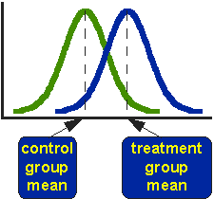
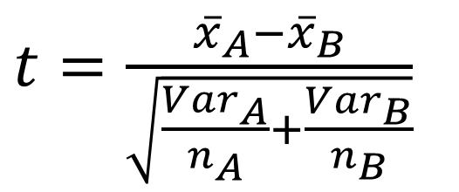
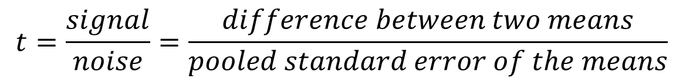
Comparing 2 Groups’ Means: t-Test
$$t=\frac{signal}{noise}=\frac{difference between two means}{pooled standard error of the means}$$
$t=\frac{{\overline{x}}_{A}−{\overline{x}}_{B}}{\sqrt{\frac{{Var}_{A}}{n_{A}}+\frac{{Var}_{B}}{n_{B}}}}$

Slide 6
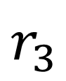
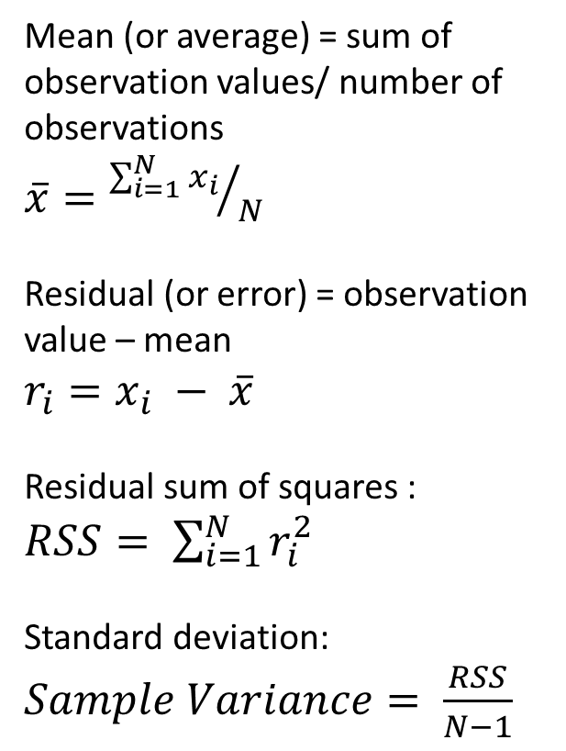
Median, Mean and Variance
Mean (or average) = sum of observation values/ number of observations
$\overline{x}={\sum_{i=1}^{N}{x_{i}}}/N$
Residual (or error) = observation value – mean
$r_{i}=x_{i} − \overline{x}$
Residual sum of squares :
$RSS= \sum_{i=1}^{N}{r_{i}^{2}}$
Standard deviation:
$Sample Variance= \frac{RSS}{N−1}$
Obs. | Value
2 | 1
4 | 2
1 | 3
5 | 7
3 | 12
$$r_{3}$$
Source: https://www.123rf.com/photo_42732599_a-cartoon-queen-with-a-confused-expression-.html

Slide 7
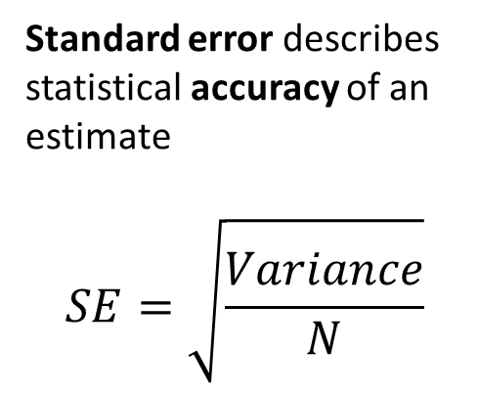
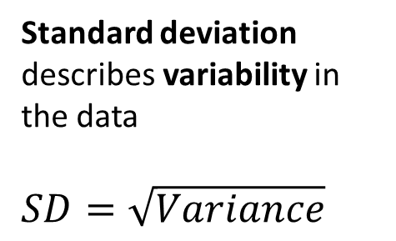
Standard Deviation vs. Standard Error
Population mean = 100; SD = 10
Standard deviation describes variability in the data
$SD=\sqrt{Variance}$
Standard error describes statistical accuracy of an estimate
$$SE=\sqrt{\frac{Variance}{N}}$$

Slide 8
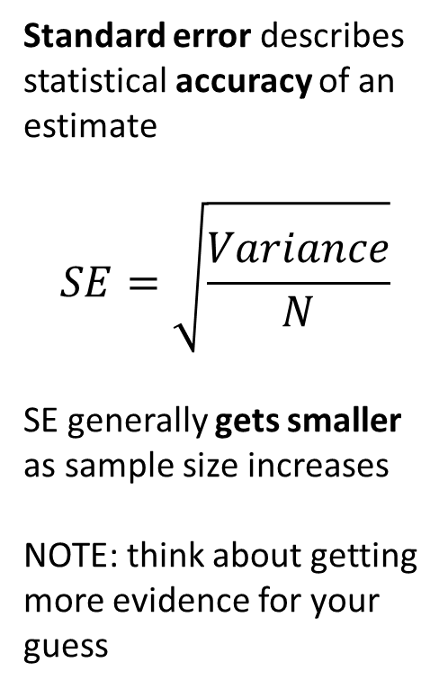
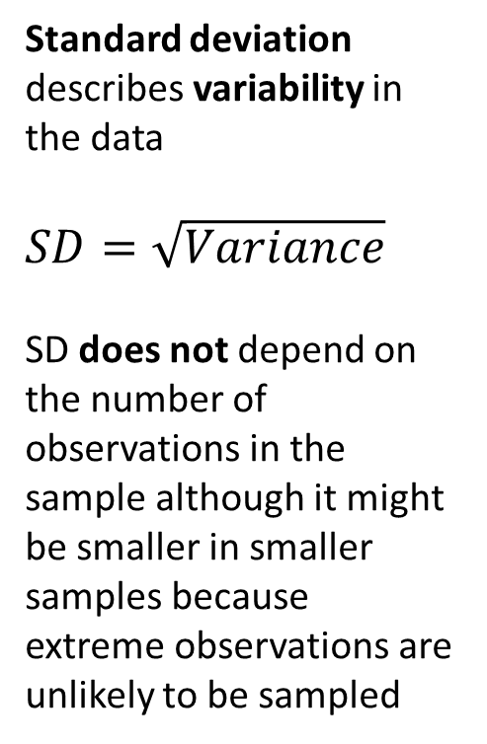
Standard Deviation vs. Standard Error
Population mean = 100; SD = 10
Standard deviation describes variability in the data
$SD=\sqrt{Variance}$
SD does not depend on the number of observations in the sample although it might be smaller in smaller samples because extreme observations are unlikely to be sampled
Standard error describes statistical accuracy of an estimate
$$SE=\sqrt{\frac{Variance}{N}}$$
SE generally gets smaller as sample size increases
NOTE: think about getting more evidence for your guess
 | 10 samples | 100 samples
SD | 9.73 | 10.40
SEM | 3.08 | 1.04

Slide 9
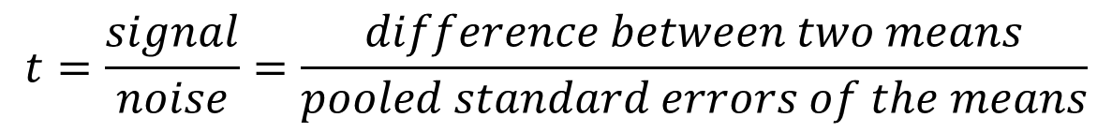
Comparing 2 Groups’ Means: t-Test
$$t=\frac{signal}{noise}=\frac{difference between two means}{pooled standard errors of the means}$$
$t=\frac{{\overline{x}}_{A}−{\overline{x}}_{B}}{\sqrt{\frac{{Var}_{A}}{n_{A}}+\frac{{Var}_{B}}{n_{B}}}}$

Slide 10
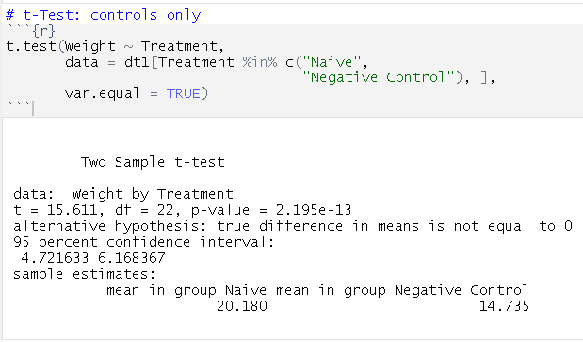
The Royal Guinea Pig Problem
Compare the two means

Slide 11
Two sample t-test assumptions
Data values must be independent: measurements for one observation do not affect measurements for any other observation.
Data in each group must be obtained via a random sample from the population.
Data in each group are normally distributed.
Data values are continuous.
The variances for the two independent groups are equal.

Slide 12
Two sample t-test assumptions: check
Data values must be independent: measurements for one observation do not affect measurements for any other observation.
Data in each group must be obtained via a random sample from the population.
Data in each group are normally distributed.
Data values are continuous.
The variances for the two independent groups are equal.

Slide 13
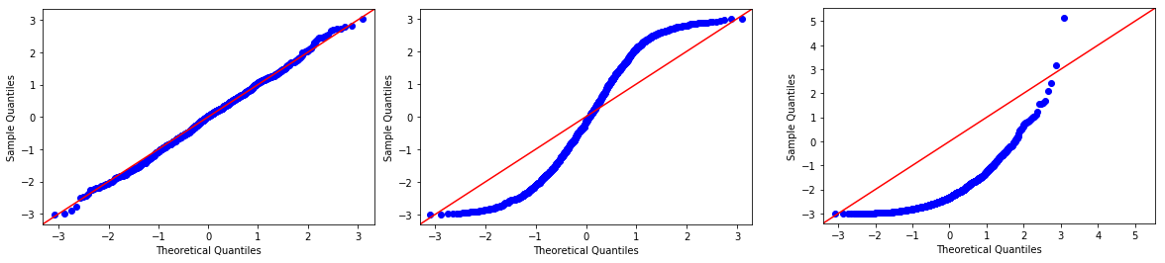

Checking t-test assumptions: (1) normality
qq-plot to check for Normality

Slide 14
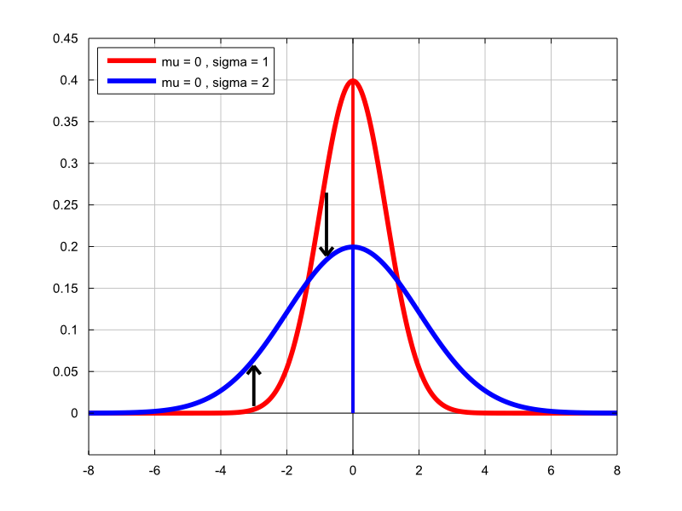
Checking t-test assumptions: (2)equal variances
2 variances are NOT equal!
Use the unequal variance t- test, also called the Welch t- test.

Slide 15
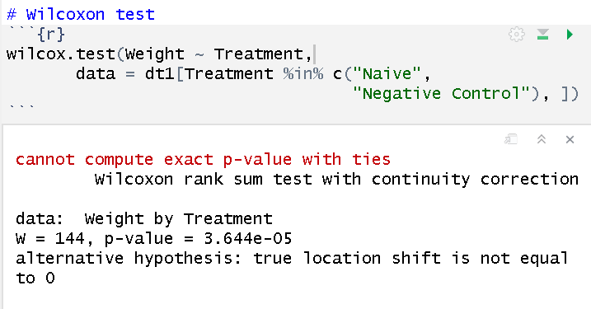
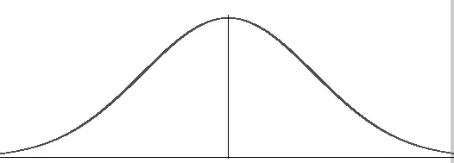
What if data is not Normally distributed?
Use Wilcoxon test - non-parametric (distribution-free)!

Slide 16
What if data has outliers?
An outlier is a data point that differs significantly from other observations in a group
Use Wilcoxon test!
If you can explain the outlier, you can remove it (needs good justification). Can create a problem (Ozone layer data example)

Slide 17
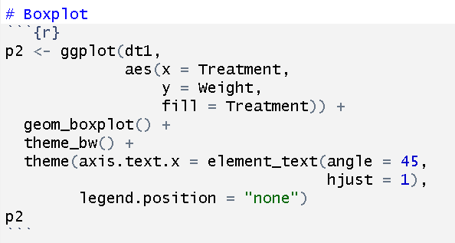
Boxplot

Slide 18
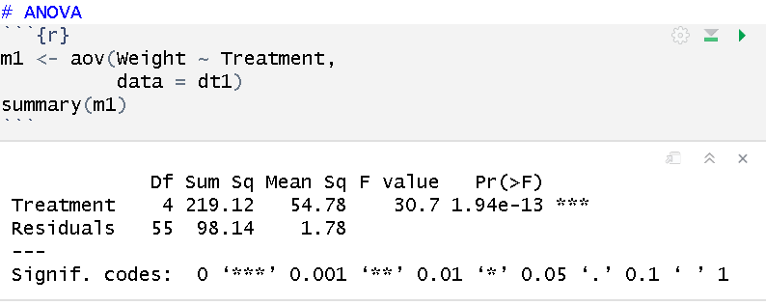
Analysis of Variance (ANOVA)

Slide 19
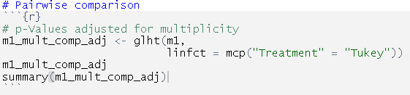
POST HOC Pairwise Comparison

Slide 20
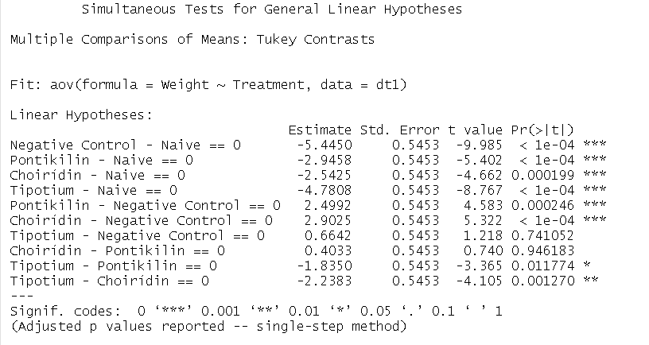
POST HOC Pairwise Comparison

Slide 21
What About the Diet?
Let’s do this one together (class exercise)
Think about how diet affects the outcome (weight)
How does diet interact with the treatment?
How can we analyze diet effect ?

Slide 22
What Are Our Recommendations?
Is there any treatment that might prevent weight loss in the guinea pig?
Are some treatments better than others? Why and why not?
What limitations did your experiment have?
What would you do differently if you had more time and recourses?

Slide 23

The Royal Guinea Pig Problem
And they lived happily ever after…
Because You found the cure!
Source: https://www.123rf.com/photo_42732599_a-cartoon-queen-with-a-confused-expression-.html

Slide 24

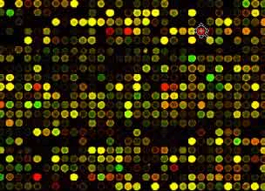

Case study
♦ Experiment: Compare the gene expression profiles of 3 KO mice vs 3 WT mice using a microarray with 22283 genes.
WT:
C1
C2
C3
KO:
T1
T2
T3
Hereafter: variables = genes

Slide 25
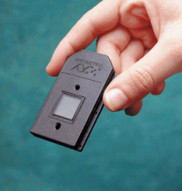
Gene expression matrix
♦ Data: Expression measures for G genes in N samples:
C1 C2 C3 T1 T2 T3
G1 83 94 82 111 130 122
G2 16 14 7 2 11 33
G3 490 879 193 604 1031 962
G4 46458 49268 74059 44849 42235 44611
G5 32 70 185 20 25 19
G6 1067 891 546 906 1038 1098
G7 118 111 95 896 536 695
G8 10 30 25 24 31 28
G9 166 132 162 27 109 213
G10 136 139 44 62 23 135
. . . . . . . . . . . .
C1 C2 C3 T1 T2 T3
G8521 6.89 7.18 6.60 7.40 7.15 7.40
G8522 6.78 6.55 6.37 6.89 6.78 6.92
G8523 6.52 6.61 6.72 6.51 6.59 6.46
G8524 5.67 5.69 5.88 7.43 7.16 7.31
G8525 5.64 5.91 5.61 7.41 7.49 7.41
G8526 4.63 4.85 5.72 5.71 5.47 5.79
G8527 8.28 7.88 7.84 8.12 7.99 7.97
G8528 7.81 7.58 7.24 7.79 7.38 8.60
G8529 4.26 4.20 4.82 3.11 4.94 3.08
G8530 7.36 7.45 7.31 7.46 7.53 7.35
G8531 5.30 5.36 5.70 5.41 5.73 5.77
G8532 5.84 5.48 5.93 5.84 5.73 5.73
G8533 9.45 9.56 9.92 10.15 9.81 9.36
G8534 7.57 7.55 7.30 7.48 7.82 7.46
Preprocess: normalize and log transform
22283 rows (genes) x 6 columns (samples)
25

Slide 26
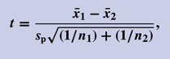
It is better to log transform!
For each row -> Compute t-statistic and p-value

Slide 27
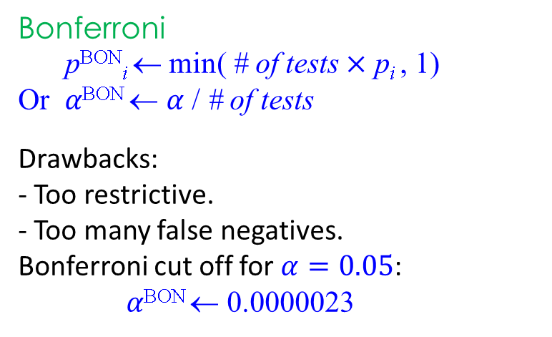
Bonferroni method: Control for multiplicity
Top 10 genes (sorted by t-test p-value)
Gene Fold Dir p p(Bonf)
G6546 2.36 D 0.000004 0.0964
G19945 3.25 U 0.000005 0.1102
G21586 1.64 U 0.000008 0.1765
G18970 2.52 U 0.000019 0.4220
G7432 3.70 D 0.000033 0.7248
G19057 1.85 U 0.000046 1.0000
G17361 4.34 D 0.000067 1.0000
G8525 5.57 D 0.000067 1.0000
G425 18.11 D 0.000078 1.0000
G8524 4.74 D 0.000109 1.0000
Bonferroni
p^{BON}_{i} ← min( # of tests $×$ p_{i} , 1)
Or $α\text{BON}$ ← $α$ / # of tests
Drawbacks:
- Too restrictive.
- Too many false negatives.
Bonferroni cut off for $α=0.05$:
$α\text{B}\text{ON}$ ← 0.0000023
How to make improvements
False discoveries correction:
Put p-values in order
0.000004 0.000005 0.000008
Multiply by # of tests up to that one
22211 22210 22209

Slide 28
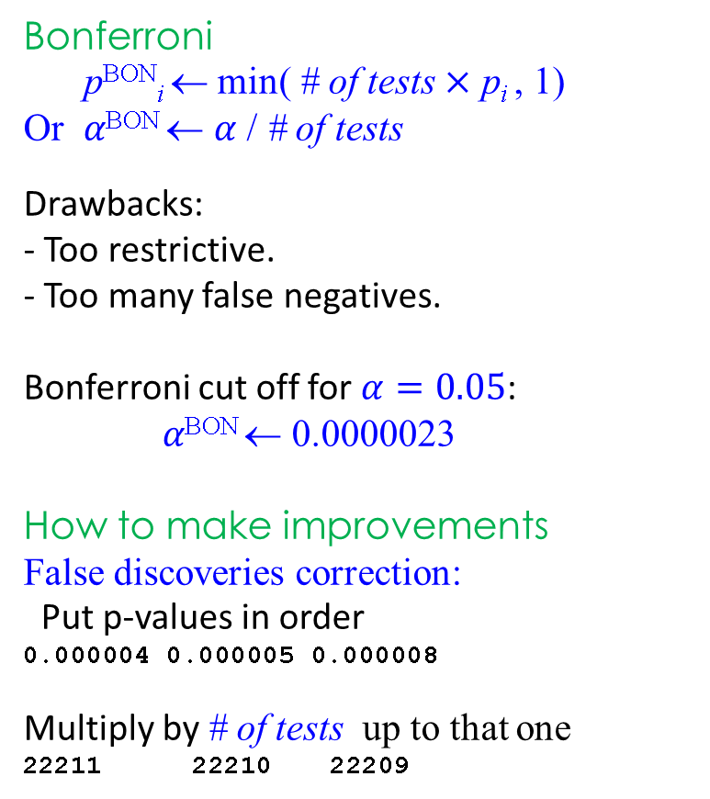
Bonferroni method: Control for multiplicity
Bonferroni
p^{BON}_{i} ← min( # of tests $×$ p_{i} , 1)
Or $α\text{BON}$ ← $α$ / # of tests
Drawbacks:
- Too restrictive.
- Too many false negatives.
Bonferroni cut off for $α=0.05$:
$α\text{B}\text{ON}$ ← 0.0000023
How to make improvements
False discoveries correction:
Put p-values in order
0.000004 0.000005 0.000008
Multiply by # of tests up to that one
22211 22210 22209
Top 10 genes (sorted by t-test p-value)
Gene Fold Dir p p(Bonf)
G6546 2.36 D 0.000004 0.0964
G19945 3.25 U 0.000005 0.1102
G21586 1.64 U 0.000008 0.1765
G18970 2.52 U 0.000019 0.4220
G7432 3.70 D 0.000033 0.7248
G19057 1.85 U 0.000046 1.0000
G17361 4.34 D 0.000067 1.0000
G8525 5.57 D 0.000067 1.0000
G425 18.11 D 0.000078 1.0000
G8524 4.74 D 0.000109 1.0000

Slide 29
T-tests for microarrays or RNAseq
## find this library at https://sites.rutgers.edu/javier-cabrera/research/
library(DNAMR)
data(mice.A)
par(mfrow=c(1,2))
hist(mice.Ar[,1],100,col=7,xlab="Gene expression",main="Gene Expression Raw scale")
hist(log(mice.Ar[,1]),20,col=7,xlab="Log Gene expression",main="Gene Expression Log scale")
data(mice.A)
data= as.matrix(mice.A)
tt= rttest(data[,1:3],data[,4:6])
head(round(tt,3))
T DF PV
[1,] 0.600 3.993 0.581
[2,] -0.412 3.888 0.702
[3,] -1.701 2.685 0.198
[4,] -0.649 3.327 0.559
[5,] -0.120 2.964 0.912
[6,] 1.572 3.969 0.192
## Top p-values
head(round(tt[sort.list(tt[,3]),],6))
T DF PV
[1,] -34.26634 3.862807 0.000006
[2,] -20.64362 3.870865 0.000042
[3,] -17.22758 3.890077 0.000081
[4,] 33.13688 2.806082 0.000100
[5,] -16.57884 3.748933 0.000120
[6,] -15.19964 3.901898 0.000129

Slide 30
T-tests p-values vs Conditional test p-values
*
*
ctpv= ct2(data[,1:3],data[,4:6])
par(mfrow=c(1,1))
plot(log(ctpv),log(tt[,3]),pch=16,col=2)
abline(0,1,col=3,lwd=2)
sort(ctpv)[1:10]*22211
[1] 0.004233567 0.015955578 0.041185283 0.145401025 0.209298907 0.282893769
[7] 0.357705307 0.420474419 0.428882406 0.466184181
P-value for t-test
P-value for conditional t-test
Similarly we developed Conditional F test and p-values
Amaratunga Cabrera (2004)
Amaratunga Cabrera & Shkedy(2014)

Slide 31
library(DNAMR)
data(Khan)
names(Khan)
names(Khan)
[1] "ImageId" "TRAIN1.EW" "TRAIN2.EW" "TRAIN3.EW" "TRAIN4.EW" "TRAIN5.EW" "TRAIN6.EW" "TRAIN7.EW" "TRAIN8.EW" "TRAIN9.EW"
[11] "TRAIN10.EW" "TRAIN11.EW" "TRAIN12.EW" "TRAIN13.EW" "TRAIN14.EW" "TRAIN15.EW" "TRAIN16.EW" "TRAIN17.EW" "TRAIN18.EW" "TRAIN19.EW"
[21] "TRAIN20.EW" "TRAIN21.EW" "TRAIN22.EW" "TRAIN23.EW" "TRAIN24.BL" "TRAIN25.BL" "TRAIN26.BL" "TRAIN27.BL" "TRAIN28.BL" "TRAIN29.BL"
[31] "TRAIN30.BL" "TRAIN31.BL" "TRAIN32.NB" "TRAIN33.NB" "TRAIN34.NB" "TRAIN35.NB" "TRAIN36.NB" "TRAIN37.NB" "TRAIN38.NB" "TRAIN39.NB"
[41] "TRAIN40.NB" "TRAIN41.NB" "TRAIN42.NB" "TRAIN43.NB" "TRAIN44.RM" "TRAIN45.RM" "TRAIN46.RM" "TRAIN47.RM" "TRAIN48.RM" "TRAIN49.RM"
[51] "TRAIN50.RM" "TRAIN51.RM" "TRAIN52.RM" "TRAIN53.RM" "TRAIN54.RM" "TRAIN55.RM" "TRAIN56.RM" "TRAIN57.RM" "TRAIN58.RM" "TRAIN59.RM"
[61] "TRAIN60.RM" "TRAIN61.RM" "TRAIN62.RM" "TRAIN63.RM" "TEST64.NB" "TEST65.EW" "TEST66.NA" "TEST67.RM" "TEST68.NA" "TEST69.EW"
[71] "TEST70.BL" "TEST71.NB" "TEST72.NA" "TEST73.RM" "TEST74.NA" "TEST75.EW" "TEST76.NA" "TEST77.NB" "TEST78.BL" "TEST79.NB"
[81] "TEST80.RM" "TEST81.BL" "TEST82.EW" "TEST83.EW" "TEST84.EW" "TEST85.RM" "TEST86.NB" "TEST87.RM" "TEST88.NB”
Data = Khan[,2:64]
Y = strsplit(names(Data),"\\.")
Y = unlist(Y)[ 2*(1:63)]
Y
[1] "EW" "EW" "EW" "EW" "EW" "EW" "EW" "EW" "EW" "EW" "EW" "EW" "EW" "EW" "EW" "EW" "EW" "EW" "EW" "EW" "EW" "EW" "EW" "BL" "BL" "BL"
[27] "BL" "BL" "BL" "BL" "BL" "NB" "NB" "NB" "NB" "NB" "NB" "NB" "NB" "NB" "NB" "NB" "NB" "RM" "RM" "RM" "RM" "RM" "RM" "RM" "RM" "RM"
[53] "RM" "RM" "RM" "RM" "RM" "RM" "RM" "RM" "RM" "RM" "RM”
# rF: row F statistics and pvalues. cF : conditional F statistics and pvalues.
pvalF= rF(Data,Y)
head(pvalF)
F pval LogFoldChange
1 15.046814 2.191233e-07 1.6731984
2 15.014638 2.250736e-07 0.5511725
3 7.232760 3.261875e-04 0.9340533
4 4.097402 1.040859e-02 0.6525674
5 1.884736 1.419950e-01 0.1345435
1.303855 2.816766e-01 1.0010550
set.seed(25437)
pvalCF = cF(Data,Y))
plot(log(pvalCF),log(pvalF[,2]),pch=16,col=2)
abline(0,1,col=3,lwd=2)
Log P-value for F-test
Log P-value for conditional F-test

Slide 32
Questions

Slide 33
References
https://www.statlearning.com/

